Slide 1
Telling a story in English

Slide 2
What is a short story/ anecdote ?
A story is a piece fiction or real narration that has a limited number of words, only a few characters and one theme.
Anecdotes are short stories about something that happened to you or to someone you know.
parts of a story: Usually a story has beginning, plot and end.

Slide 3
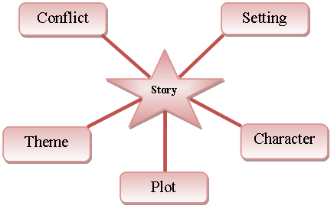
ELEMENTS OF A STORY

Slide 4
How to start
Traditional stories often start with the phrase "Once upon a time".
Other expressions:
Long ago when…: hace mucho tiempo cuando…
There was a time when… hubo una epoca en que…

Slide 5
How to tell your story
First of all, your story should be quite short. Try to keep it grammatically simple as well, so that it is easy to follow.

Slide 6
Sequencing words
These words show the chronological sequence of events.
First of all, I (packed my suitcase) ()
Secondly, I …. (made sure I had all my documents)
Previously (before that) ….. I changed some money
Then… I (called a taxi for the airport)
Later (on)… (when we were stuck in traffic, I realised…)
But before all that… (I had double checked my reservation)
Finally… (I arrived at the wrong check-in desk at the wrong airport for a flight that didn't go until the next day)

