Slide 1
Numbers
0 - Zero
1 – one
2 - two
3 - three
4 - four
5 - five
6 - six
7 - seven
8 - eight
9 – nine
10 – ten
11 - eleven
12 - twelve
13 - thirteen
14 - fourteen
15 – fifteen
16 - sixteen
17 - seventeen
18 – eighteen
19 - nineteen
20 - twenty

Slide 2
Numbers
21 - twenty-one
22 - twenty-two
23 - twenty-three
30 - thirty
40 - forty
50 - fifty
60 - sixty
70 - seventy
80 - eighty
90 - ninety
100 - one hundred*
101 - one hundred and one
200 - two hundred
300 - three hundred
1,000 - one thousand
1,000,000 - one million
10,000,000 - ten million

Slide 3
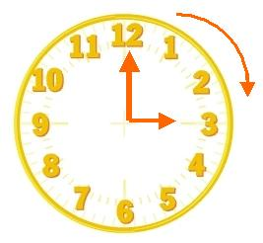
What time is it? – ¿que hora es ?
La hora en punto
It is three o´clock
Son las tres en punto
It´s three sharp

Slide 4
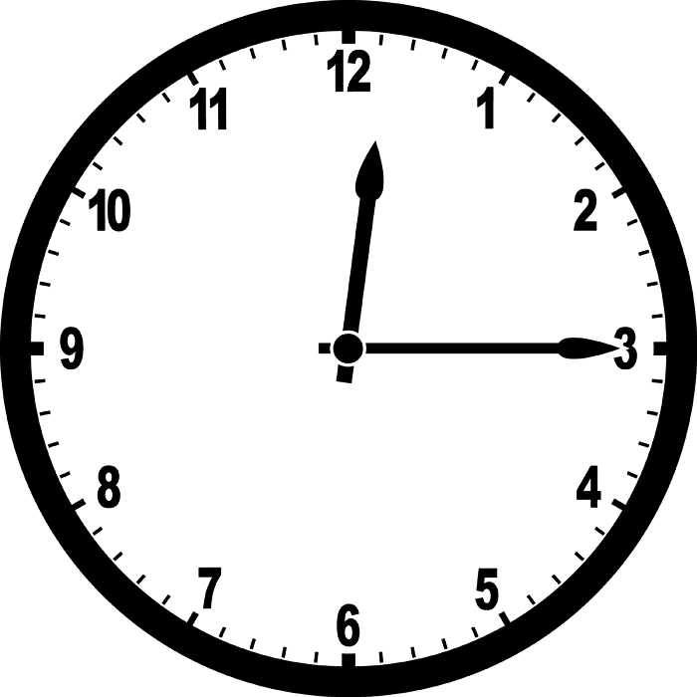
What time is it?
La hora y cuarto
Quarter = cuarto –fraccion
It is twelve and a quarter
Son las doce y cuarto
It is fifteen past twelve
Son las doce y quince
It is twelve (and) fifteen (minutes)

Slide 5
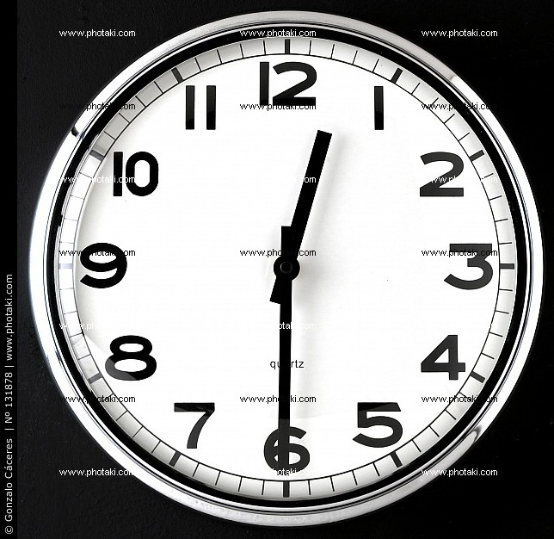
What time is it?
La hora y media
Half= mitad- medio
It is twelve and a half
Son las doce y media
It is thirty past twelve
It is twelve and thirty (minutes)
Son las doce y treinta ( minutos)

Slide 6
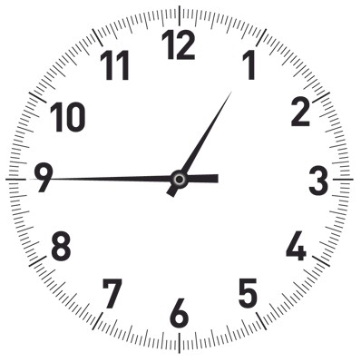
What time is it?
Cuando faltan minutos para la hora
It is a quarter to one
Un cuarto para la una
It is fifteen to one
Quince para la una
Tambien:
It’s forty-five past twelve
Las doce y cuarentaycinco

