Slide 3
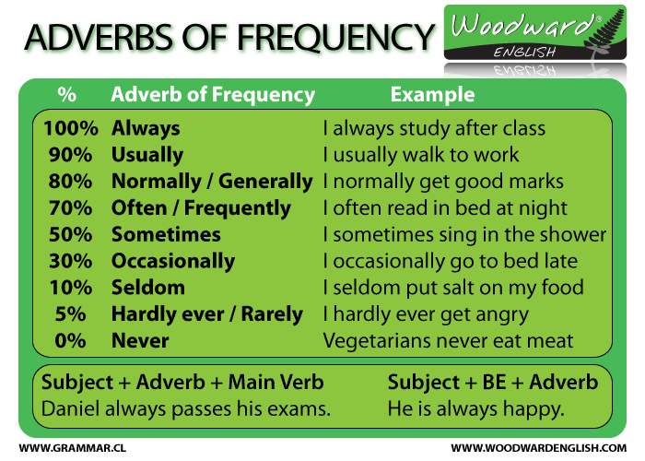

Slide 4
examples
I always eat at two o'clock | Siempre como a las dos
You don't go to the cinema very often | No vas al cine muy a menudo
He often sings in this pub | A menudo canta en el bar
She usually arrives late at work | Normalmente llega tarde al trabajo
It hardly ever works | Casi nunca funciona
We sometimes feel tired | A veces nos sentimos cansados
You rarely drink milk | Rara vez bebéis leche
They never do this kind of things | Ellos nunca hace ese tipo de cosas

