Slide 1
VERBOS IRREGULARES

Slide 2
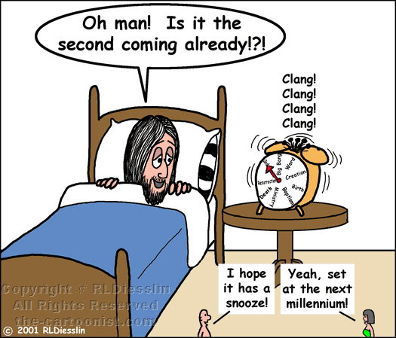
Awake- awoke - awoken

Slide 3
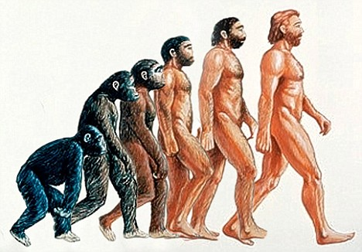
Become – became - become

Slide 4
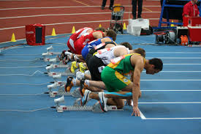
Begin – Began - begun

Slide 5
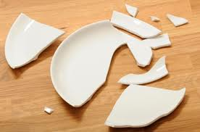
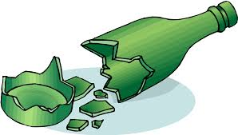
BREAK – BROKE - BROKEN

Slide 6
Bring – brought - broutht

Slide 7
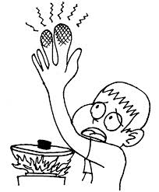
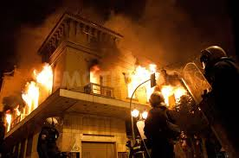
BURN – BURNT/BURNED

Slide 8
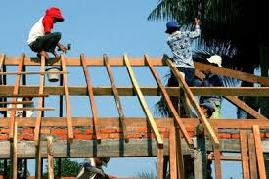
Build – Built - Built

Slide 9
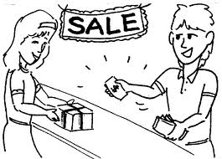
Buy – Bought - Bought

Slide 10
Choose- chose - chosen

Slide 11
Come- came - Come

Slide 12
Cut – cut – cut

Slide 13
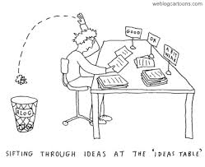
Do – Did - Done

Slide 14
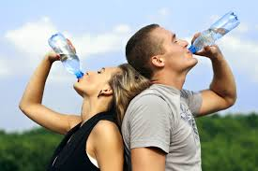
Drink – Drank - Drunk

Slide 15
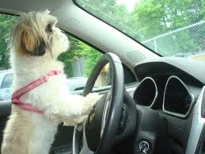
Drive –Drove - Driven

Slide 16
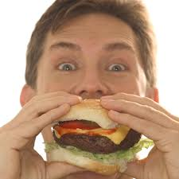
Eat – Ate - Eaten

Slide 17
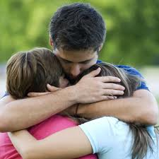
Feel – Felt - Felt

Slide 18
Find – Found - Found

Slide 19
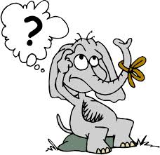
Forget – Forgot - Forgotten

Slide 20
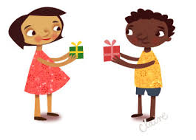
Give – Gave - Given

Slide 21
Go – went - Gone

Slide 22
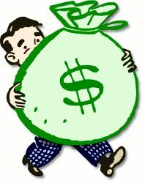
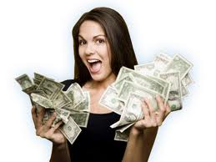
Have – Had - Had

Slide 23
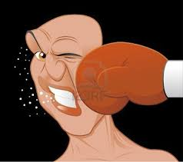
Hit - hit – hit

Slide 24
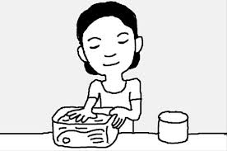
Keep – Kept - Kept

Slide 25
Know – knew - Known

Slide 26
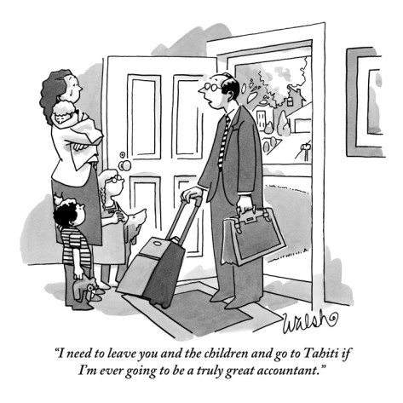
Leave – Left - Left

Slide 27
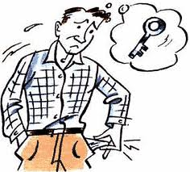
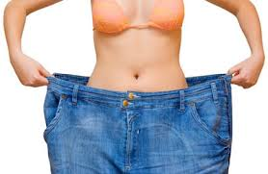
Lose – lost

Slide 28
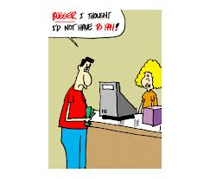
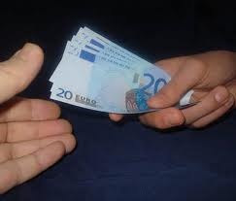
Pay – paid - Paid

Slide 29
Put – put – put

Slide 30
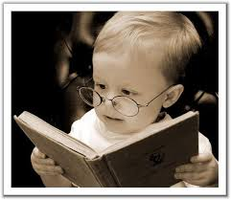
Read – Read - Dead

Slide 31
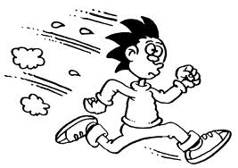
Run – Ran - Run

Slide 32
SAY – SAID – SAID DECIR

Slide 33
Tell – told – told comentar-decir

Slide 34
See - saw

Slide 35
Send – sent – sent

Slide 36
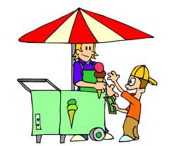
Sell - Sold

Slide 37
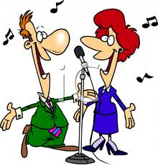
Sing – sang - sung

Slide 38
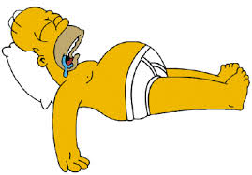
Sleep – slept - slept

Slide 39
Speak – spoke - spoken

Slide 40
Swim – swam - swum

Slide 41
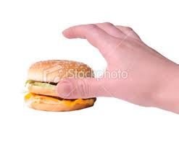
Take – Took – Taken

Slide 42
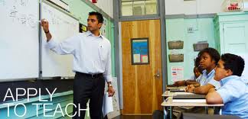
Teach – Taught - Taught

Slide 43
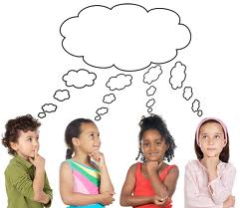
Think – Thought - Thought

Slide 44
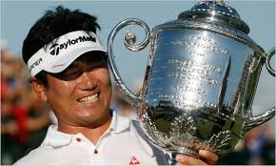
Win – Won – won

Slide 45
Write – wrote – written

