Slide 1
REGULAR VERBS
son aquellos que para formar su pasado y su participio se le añade la terminación “ED” a su forma presente. Si la forma presente termina en “E” agregue solo la “D”

Slide 2
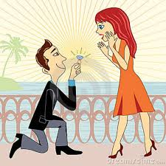
Accept - Accepted

Slide 3
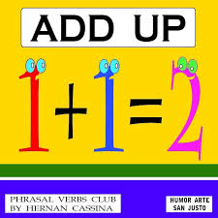
Add - added

Slide 4
Answer- answered

Slide 5
ASK - ASKED

Slide 6
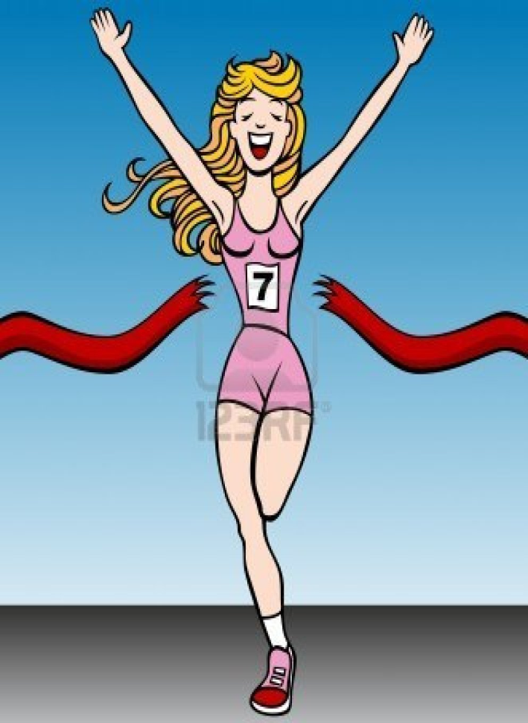
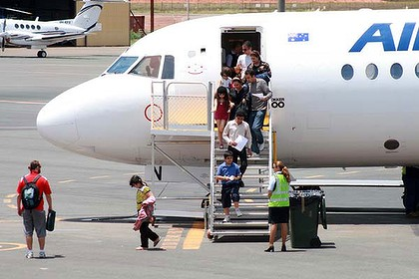
Arrive -arriveD

Slide 7
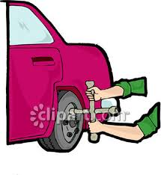
Change - changeD

Slide 8
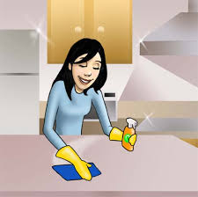
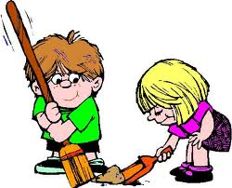
Clean - cleaned

Slide 9
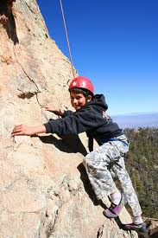
Climb - Climbed

Slide 10
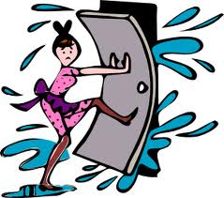
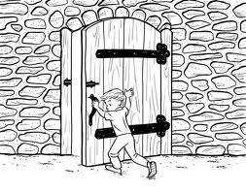
Close - closed

Slide 11
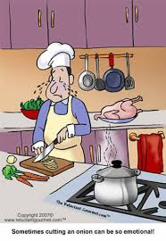
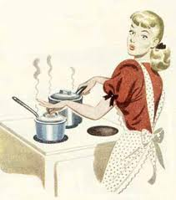
Cook - cooked

Slide 12
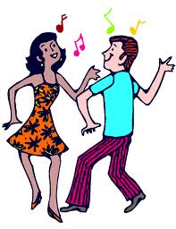
Dance - danceD

Slide 13
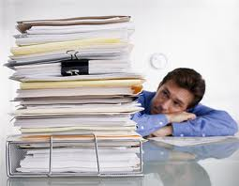
End - Ended

Slide 14
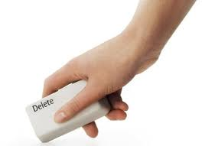
Erase - erased

Slide 15
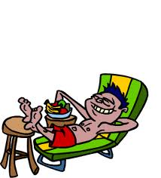
Enjoy - enjoyed

Slide 16
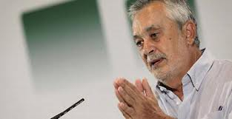
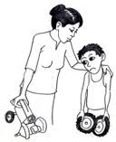
Apologise – apologised disculparse

Slide 17
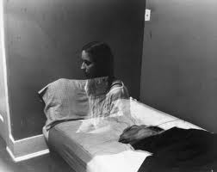
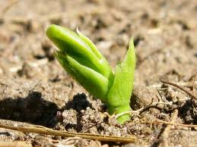
Appear – appeared aparecer

Slide 18
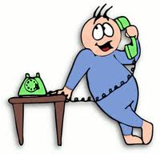
Call - called

Slide 19
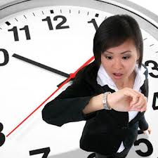
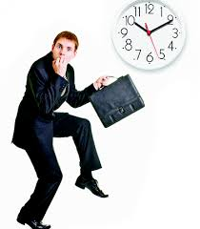
Delay – delayed retrasarse

Slide 20
Destroy - Destroyed

Slide 21
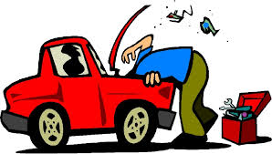
Fix - fixed

Slide 22
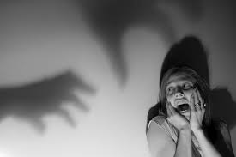
Fear - feared temer

Slide 23
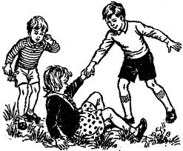
help - helped

Slide 24
Hug - hugged

Slide 25
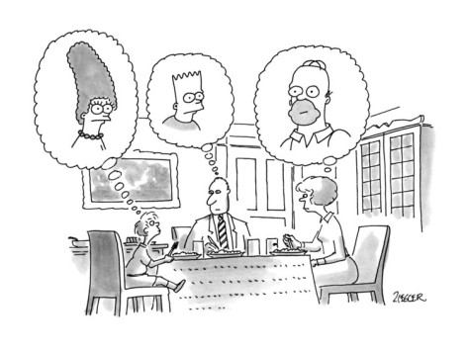
Imagine - imagined

Slide 26
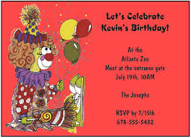
Invite - invited

Slide 27
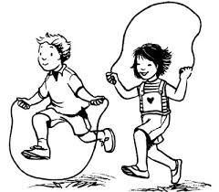
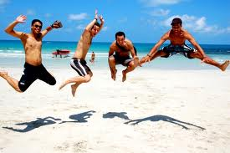
Jump - jumped

Slide 28
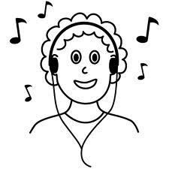
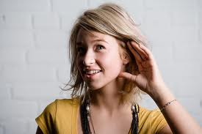
Listen – listened

Slide 29
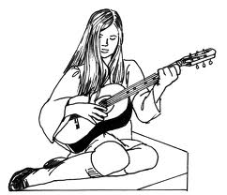
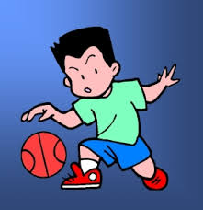
Play- played

Slide 30
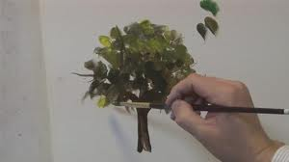
Paint - painted

Slide 31
Like – liked (gustar)

Slide 32
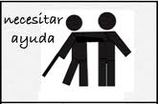
Need – needed ( necesitar)

Slide 33
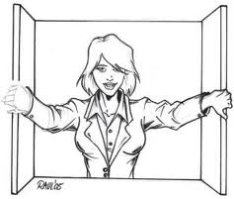
Open – opened

Slide 34
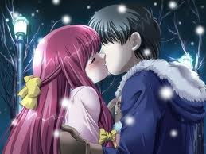
kiss - kissed

Slide 35
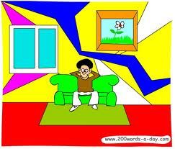
Live – lived (vivir)

Slide 36
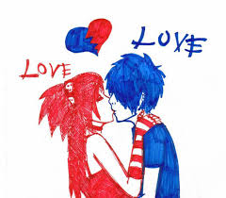
Love - loved

Slide 37
Remember - remembered

Slide 38
stop - stopped

Slide 39
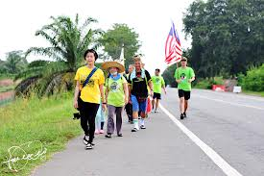
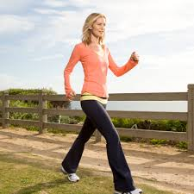
Walk -walked

Slide 40
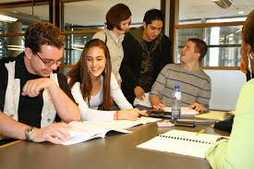
Study - studied

Slide 41
Travel - traveled

Slide 42
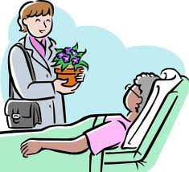
Visit - visited

Slide 43
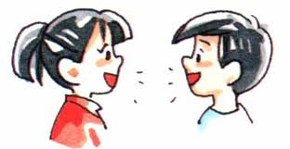
Talk - talked

Slide 44
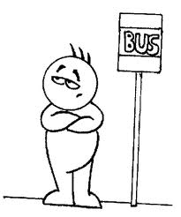
Wait – waited

Slide 45
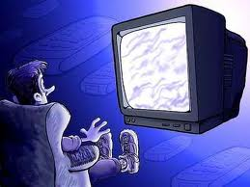
Watch - watched

Slide 46
Work - worked

